Slide 1
Restaurant Recommendation System Using CBF
Neha Bais
MET-CS777 Term Project
Spring’21

Slide 2
Recommendation Systems
Recommendation system aims to predict users’ interests and recommend product items that they might like.
Online retailers mainly use them to drive their sales.
Data required for this is collected through:
Explicit feedback: User ratings after watching a movie or listening a song
Implicit Feedback: Gathered through users’ activities, like purchase history, number of clicks, how long they spent on reading an article etc.

Slide 3
Why do we need Recommendation System
For Users:
Speed up searches
Easy to access content they might be interested in
Receive many offers they would have never searched for
For Companies:
Attracts customers
Competitive advantage by reducing the threat of losing their customers to their competitors
Increase their earnings

Slide 4
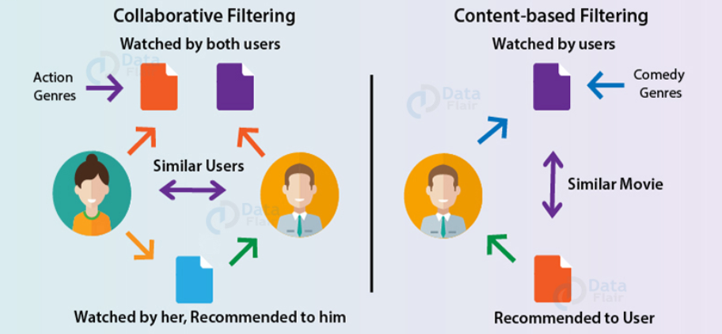
Types of Recommendation System
Image Source: DataFlair Blog

Slide 5
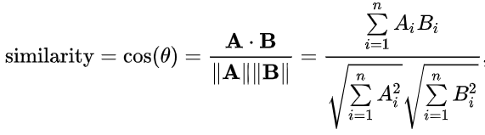
Content Based Filtering
Content based filtering uses item features to recommend other items similar to what user likes, based on their previous actions or explicit feedbacks.
Uses distance metrices to evaluate how similar 2 items are based on users’ feedback.
Recommend most similar items to users.
Cosine similarity

Slide 6
Dataset
Yelp businesses, reviews and users data.
Contains information of businesses across 8 metro cities of US and Canada
Source:
https://www.kaggle.com/yelp-dataset/yelp-dataset?select=yelp_academic_dataset_business.json

Slide 7
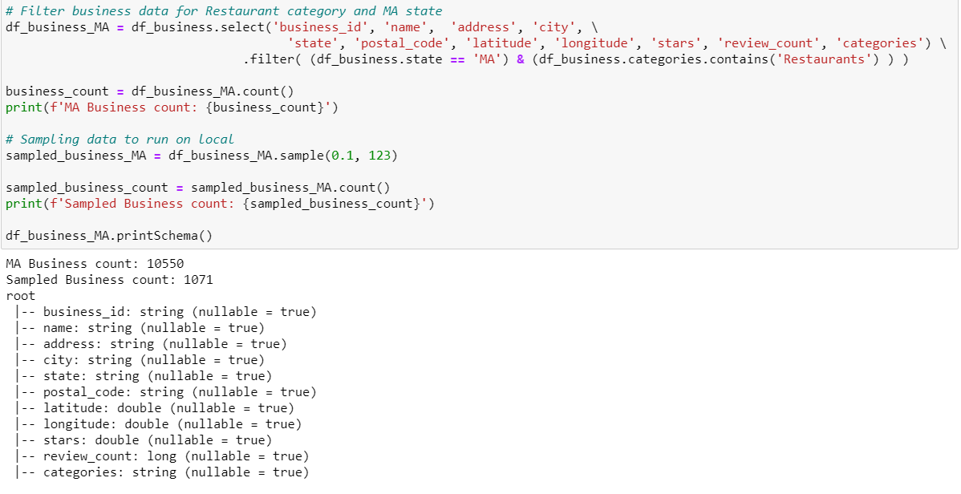
Data Preprocessing
Business data

Slide 8
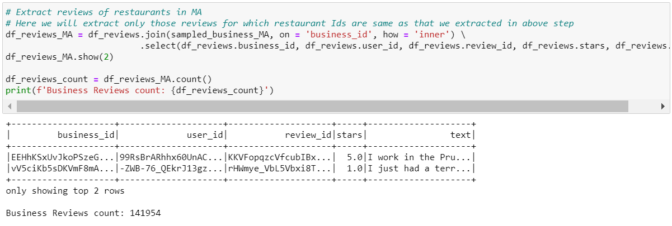
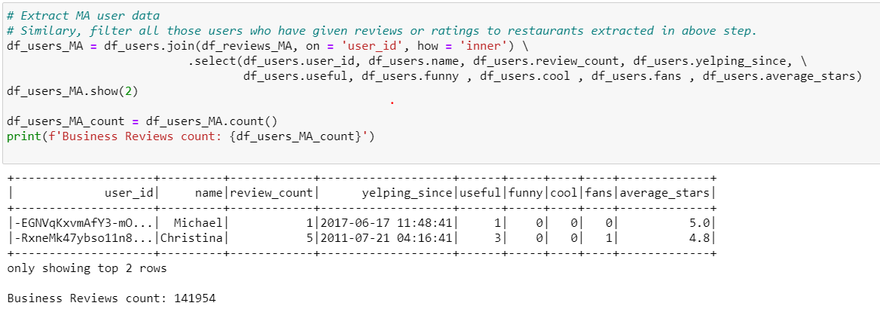
Data Preprocessing
Reviews data
Users data

Slide 9

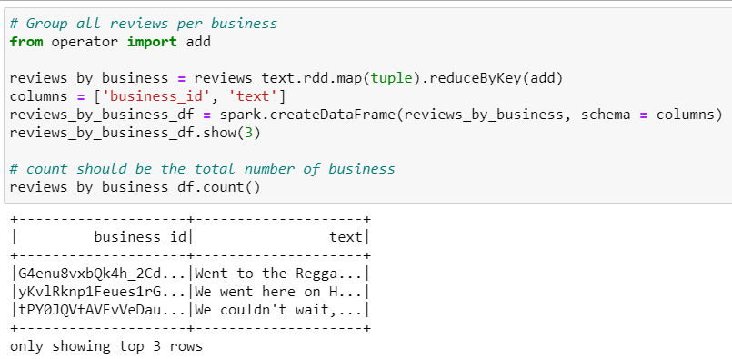
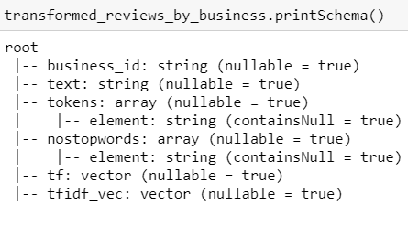
Data Preprocessing

Slide 10
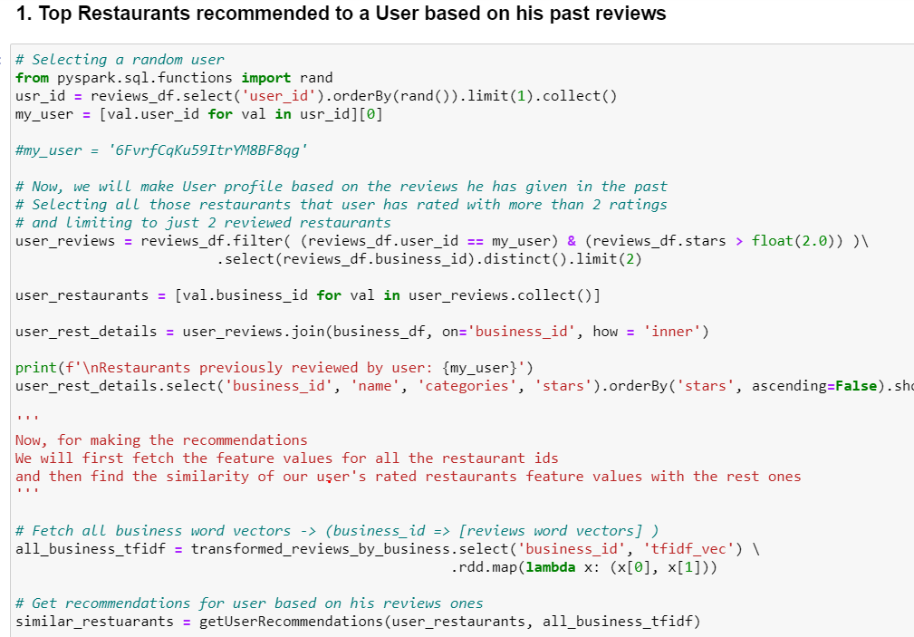
Making Recommendations for User

Slide 11
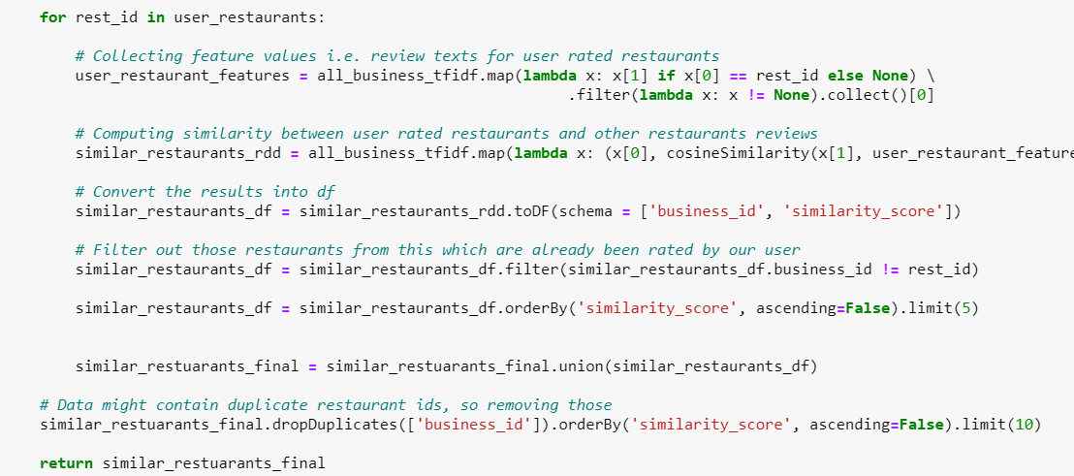
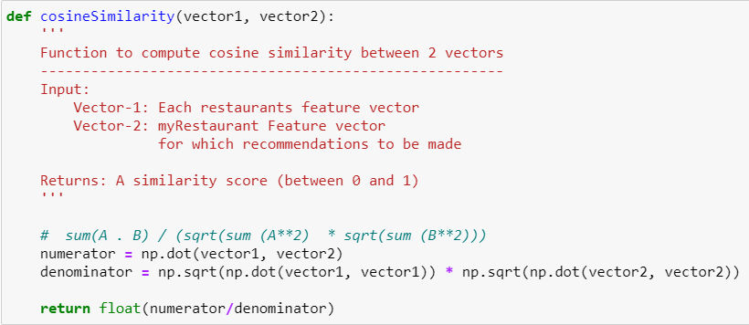
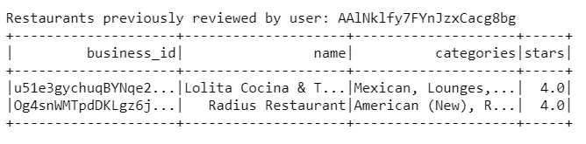
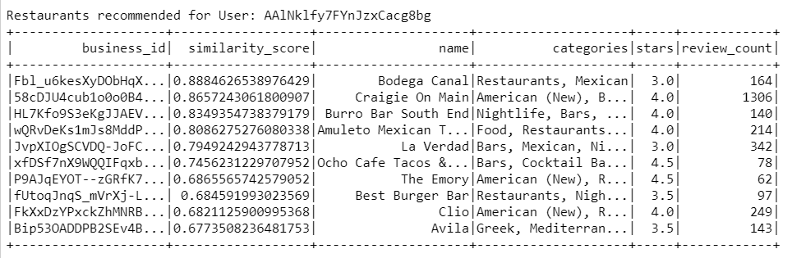

Slide 12
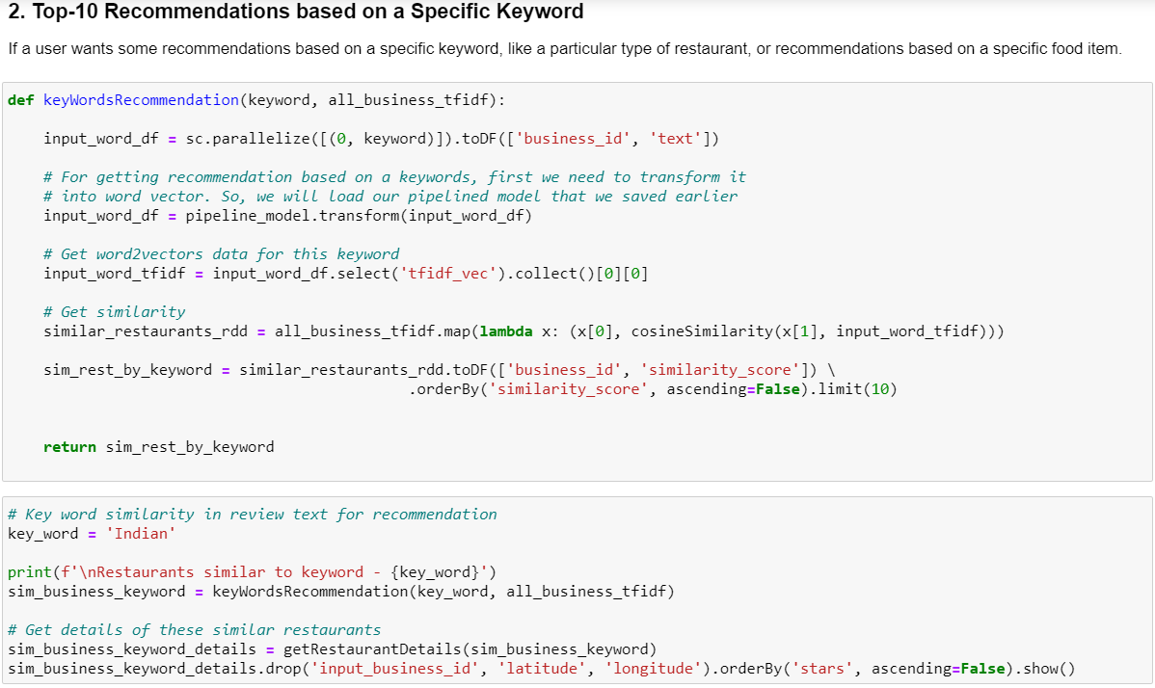
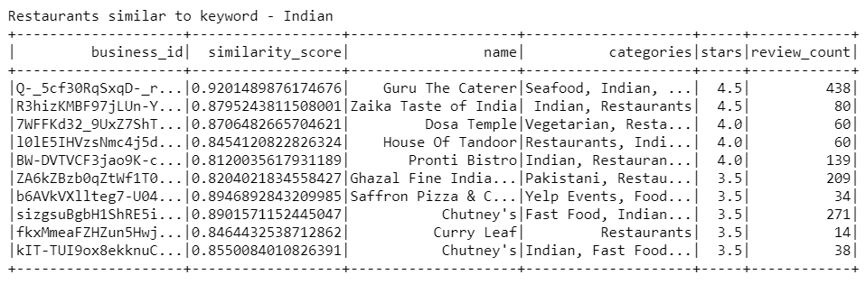
Recommendations based on a keyword

Slide 13
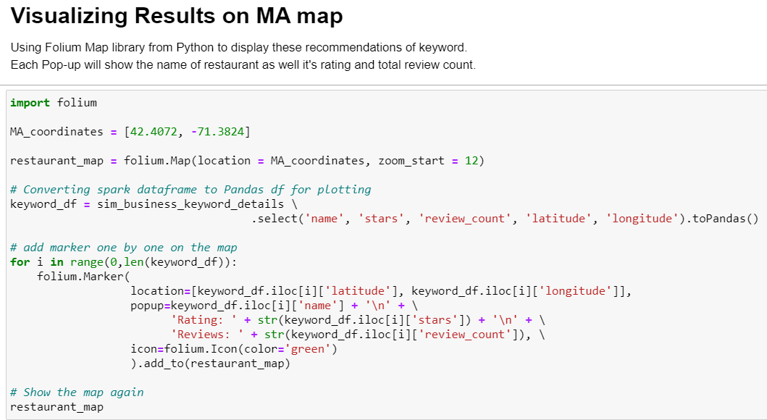
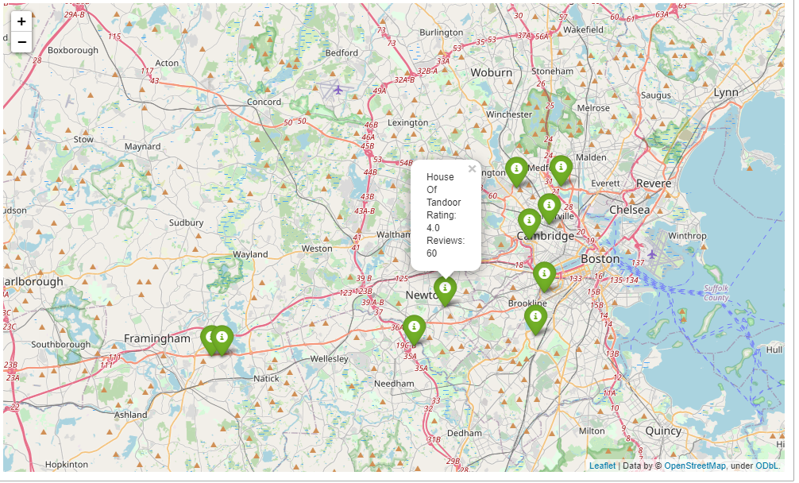
Visualization of recommended restaurants

Slide 14
Conclusion
Pros:
CBF does not need any data about other users to recommend something to a user.
Highly personalized for user.
Cons:
Requires a lot of domain knowledge.
Limited ability to expand of users’ existing interests.
Future scope:
Implementing Collaborative filtering that takes other similar interest users as well to recommend items to my user.

Slide 15
Thank You !!!

